Slide 1
Homework 4
Henry Belik

Slide 2

Topics
Oscillatory motion
Driven damped pendulum
Damped pendulum
Resonance

Slide 3


Problem 3.6
We know that in a pendulum, there are 3 damping regimes, underdamped, critically damped, and over damped
What damping state the pendulum is in depends on the damping coefficient of the system
We know the natural frequency is

Slide 4

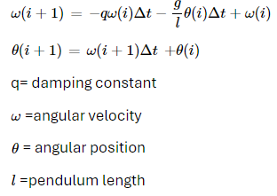
Governing Equations
Using the Euler-Cromer method, we can translate the second order differential equation governing damped pendulums into two iterate-able processes in MATLAB

Slide 5

3 regimes
If the damping constant is greater than twice the natural frequency, the pendulum is over damped
1
If the damping constant is less than twice the natural frequency, the pendulum is under damped
2
If the damping constant is about the same as twice the natural frequency, the pendulum is critically damped
3

Slide 6
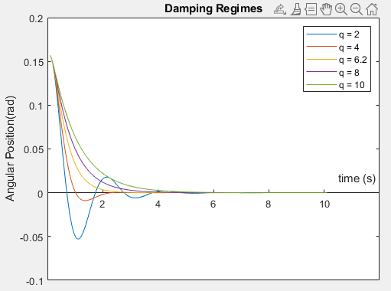
3 regimes continued
I experimentally determined that the critically damped value is about 6.2
If q is less than that, it's under damped
If q is greater than that, it's over damped

Slide 7
Time Steps function
function output = time_steps(number_of_steps, time_step)
%initialize time steps
t = zeros(1, number_of_steps + 1)'; % time
for i = 1:number_of_steps + 1
t(i, 1) = (i + 1) * time_step;
end
output = t;
end

Slide 8
Pendulum Code
function output = Pendulum(pendulum_length, damping_constant, initial_angle, initial_anular_velocity, N, time_step)
g = 9.81; %m/s
%initialize data matrix
%column 1 angular position
%column 2 angular velocity
pos_vel_data = zeros(N, 2);
%initialize data
pos_vel_data(1, 2) = 3.14 / 180 * initial_anular_velocity;
pos_vel_data(1,1) = 3.14 / 180 * initial_angle;
for i = 1:N
%angular velocity
pos_vel_data(i+1, 2) = -damping_constant * pos_vel_data(i,2) * time_step - g/pendulum_length * pos_vel_data(i, 1) * time_step + pos_vel_data(i, 2);
%angular position
pos_vel_data(i+1, 1) = pos_vel_data(i+1,2) * time_step + pos_vel_data(i, 1);
end
output=pos_vel_data;
end

Slide 9
Pendulum Implementation
N = 200;
time_step = 0.05;
t = time_steps(N, time_step);
pendulum_length = 1;
initial_angle = 9; %degrees
initial_angular_velocity = 0;
figure
w = [2, 4, 6.2, 8, 10];
for i = w
pos_vel_data = Pendulum(pendulum_length,i, initial_angle, initial_angular_velocity, N, time_step);
plot(t, pos_vel_data(:,1))
hold on
end
title('Damping Regimes')
xlabel('time (s)')
ylabel('Angular Position(rad)')
set(gca, 'XAxisLocation', 'origin')
legendStrings = "q = " + string(w);
legend(legendStrings)

Slide 10
N = 150;
time_step = 0.1;
t = time_steps(N, time_step);
q = 2;
pendulum_length = 1;
initial_angle = 9; %degrees
initial_angular_velocity = 0;
data = Pendulum(pendulum_length, q, initial_angle, initial_angular_velocity, N, time_step);
x = zeros(1, N);
y = zeros(1, N);
for i = 1:N
x(i) = pendulum_length * sind(data(i, 1));
y(i) = -pendulum_length * cosd(data(i, 1));
end
% Create a movie
writerObj = VideoWriter('underdamped_animation1.mp4', 'MPEG-4');
writerObj.FrameRate = 5; % adjust frame rate if needed
open(writerObj);
% Animation
figure;
for i = 1:length(x)
plot(0, 0, 'ro', 'MarkerSize', 10); % pivot point
hold on;
plot([0, x(i)], [0, y(i)], 'b', 'LineWidth', 2); % pendulum rod
plot(x(i), y(i), 'bo', 'MarkerSize', 20); % pendulum bob
xlim([-1.5*max(abs(x)) 1.5*max(abs(x))]);
ylim([-1.5*max(abs(y)) 1.5*max(abs(y))]);
title(['Pendulum Animation at Frame ', num2str(i)]);
xlabel('X Position (m)');
ylabel('Y Position (m)');
grid on;
hold off;
drawnow;
% Capture frame for the movie
frame = getframe(gcf);
writeVideo(writerObj, frame);
end
% Close the movie file
close(writerObj);

Slide 11
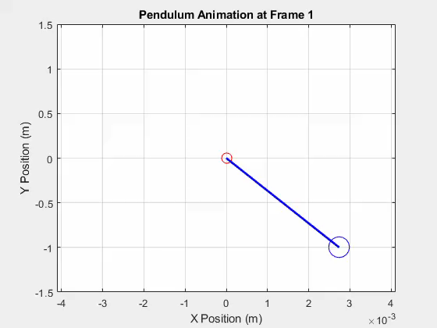
Under Damped Pendulum
q = 2;
Pendulum length = 1
Initial angle = 9 degrees
Initial angular velocity = 0;

Slide 12
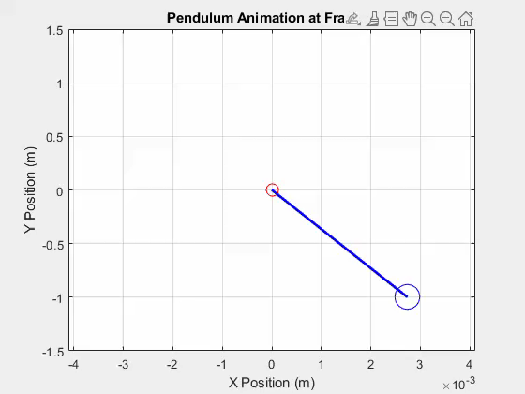
Critically Damped Pendulum
q = 6.2;
Pendulum length = 1;
Initial angle = 9 degrees
Initial angular velocity = 0

Slide 13
Over Damped Pendulum
q = 8;
Pendulum length = 1;
Initial angle = 9 degrees
Initial angular velocity = 0

Slide 14
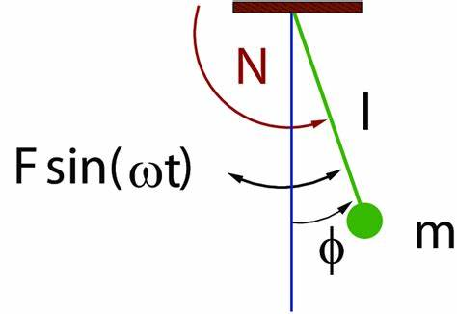
Problem 3.7
In this problem we want to explore the effects of an external driving force on a damped pendulum, hence the name driven damped pendulum

Slide 15
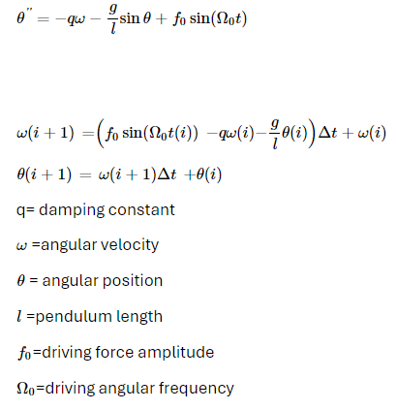
Governing Equations
Using the Euler-Cromer method, we can translate the second order differential equation governing driven damped pendulums into two iterate-able processes in MATLAB

Slide 16
function output = dd_Pendulum(pendulum_length, damping_constant, omega, driving_force, initial_angle, initial_anular_velocity, N, time_step)
g = 9.81; %m/s
%initialize data matrix
%column 1 angular position
%column 2 angular velocity
pos_vel_data = zeros(N, 2);
%initialize data
pos_vel_data(1, 2) = 3.14 / 180 * initial_anular_velocity;
pos_vel_data(1,1) = 3.14 / 180 * initial_angle;
t = time_steps(N, time_step);
for i = 1:N
%angular velocity
pos_vel_data(i+1, 2) = (driving_force * sin(omega * t(i)) - damping_constant * pos_vel_data(i,2) - g/pendulum_length * pos_vel_data(i, 1)) * time_step + pos_vel_data(i, 2);
%angular position
pos_vel_data(i+1, 1) = pos_vel_data(i+1,2) * time_step + pos_vel_data(i, 1);
end
output=pos_vel_data;
end

Slide 17
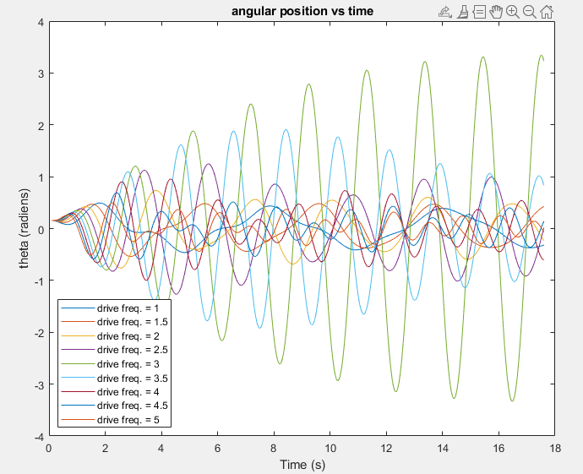
Effects of varying driving angular frequency
Knowing the simulation parameters of pendulum length = 1 and a low damping constant; we can see when the driving frequency matched most closely with the natural frequency, the largest output amplitude was produced

Slide 18
Varying driving angular frequency
N = 350;
time_step = 0.05;
t = time_steps(N, time_step);
pendulum_length = 1;
initial_angle = 9; %degrees
initial_angular_velocity = 0;
natural_frequency = sqrt(9.81 / pendulum_length);
driving_force = 1 * natural_frequency; %Newtons
q = 0.2
figure
xlabel('Time (s)')
ylabel('theta (radiens)')
values = 1:0.5:5;
for i= values
data = dd_Pendulum(pendulum_length, q, i, driving_force, initial_angle, initial_angular_velocity, N, time_step);
plot(t, data(:, 1))
hold on
end
legendStrings = "drive freq. = " + string(values);
legend(legendStrings)

Slide 19
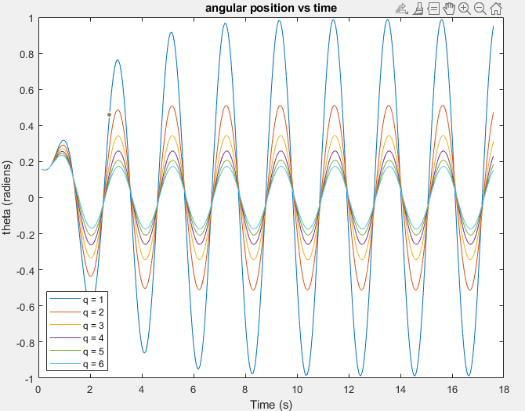
Effects of varying damping constant
We can see that when the driving angular frequency matches the natural frequency, the smaller damping constant produces larger amplitudes

Slide 20
Varying damping constant
N = 350;
time_step = 0.05;
t = time_steps(N, time_step);
pendulum_length = 1;
initial_angle = 9; %degrees
initial_angular_velocity = 0;
natural_frequency = sqrt(9.81 / pendulum_length);
figure
driving_frequency = 3;
q = 1:6;
for i = q
data = dd_Pendulum(pendulum_length, i, driving_frequency, driving_force, initial_angle, initial_angular_velocity, N, time_step);
plot(t, data(:, 1))
hold on
end
xlabel('Time (s)')
ylabel('theta (radiens)')
title('angular position vs time')
legendStrings = "q = " + string(q);
legend(legendStrings)

Slide 21

Steady State amplitude analysis
Driving angular frequency variance with a low damping constant
Constant driving angular frequency at the natural frequency with varying damping constants

